Slide 1





Sociotechnical Implications of Generative AI for Information Access
Bhaskar Mitra
Principal Researcher, Microsoft Research
@UnderdogGeek bmitra@microsoft.com http://bit.ly/bmitraMSFT
* The views expressed in this talk are my own and do not reflect that of any institutions I am affiliated with.

Slide 2


Online information access is undergoing transformative changes
What AI makes plausible
What the world needs
Generative AI may enable new ways in which we access information, but we are only starting to understand and grapple with their broader implications for society
Our world is facing a confluence of forces pushing us towards precarity (e.g., global conflicts, pandemics, and climate change) and we need robust access to reliable information in this critical time
What information access R&D should we do?

Slide 3
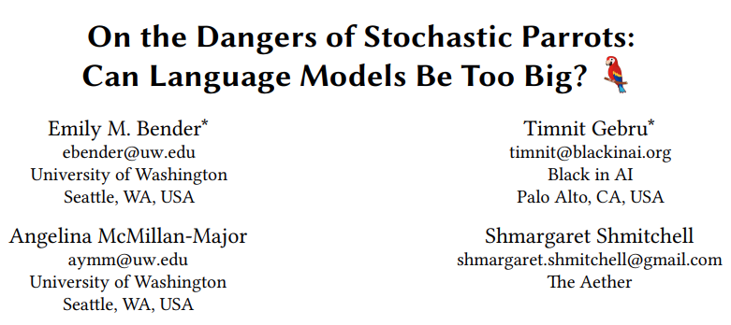
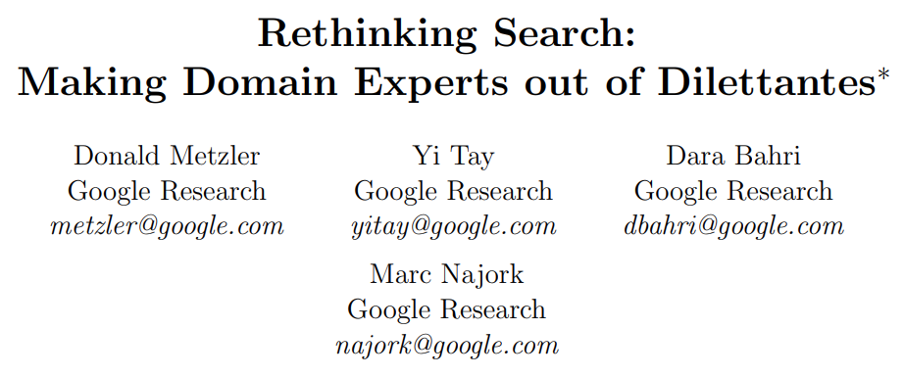
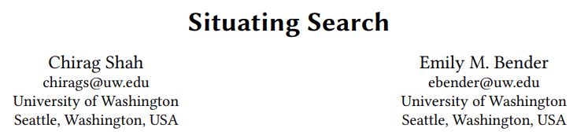
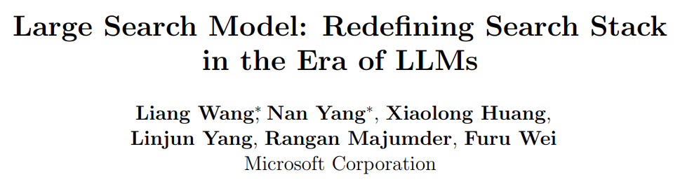
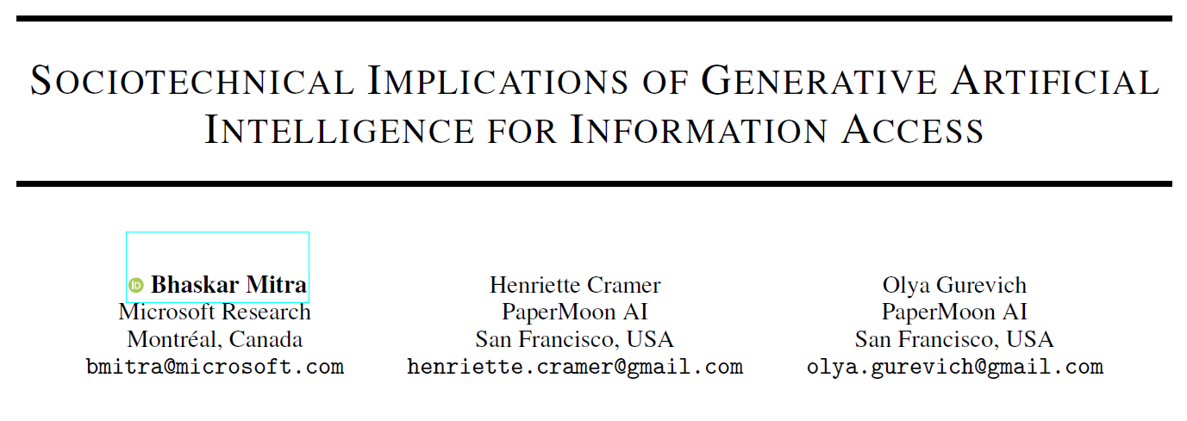
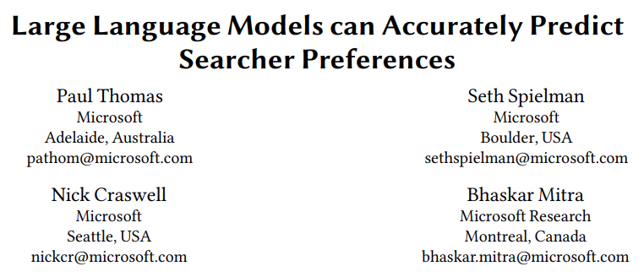


Generative AI for information access The tale of two perspectives
Helps realize new information access modalities; reimagines the information retrieval stack; predicts relevance as well as anyone besides the original searcher
Disrupts information ecosystems; increases misinformation; concentrates power; reproduces historical marginalizations; accelerates climate change
Notes:
Risks of generative AI in information access:
Disrupt our online information ecosystem
Act as misinformation superspreaders
Concentrate power
Reproduce historical marginalization
A heavy price tag of accelerating anthropogenic climate change

Slide 4
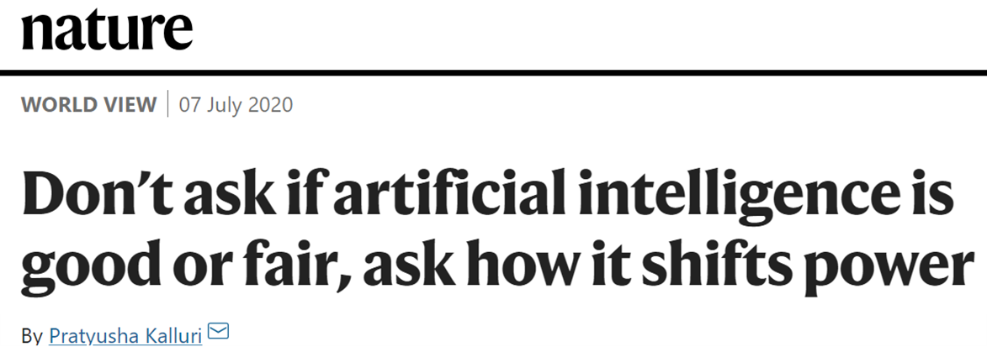
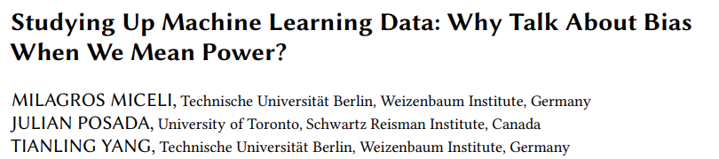
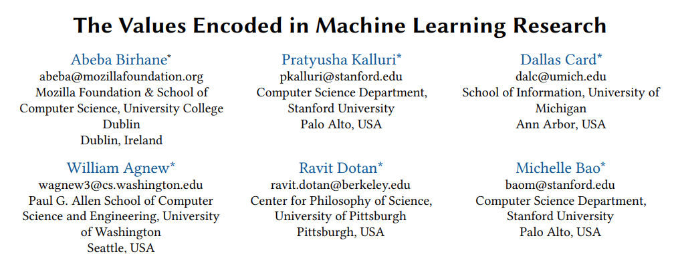
Re-interrogating fairness and bias frames in IR
If you work in responsible AI or any related area, does it feel like you are stuck in never-ending loops of enumerating the risks of technologies that are constantly emerging ?
Are we often mis-framing how AI impacts power and justice as concerns of algorithmic fairness and bias that detract from underlying sociotechnical issues?
Does the “responsible AI” frame itself center on the presupposition that AI can be made responsible and that it is just the technology, not the power concentration by those building and wielding it, that should be challenged?

Slide 5

How should we think about the sociotechnical implications of generative AI for information access?

Slide 6

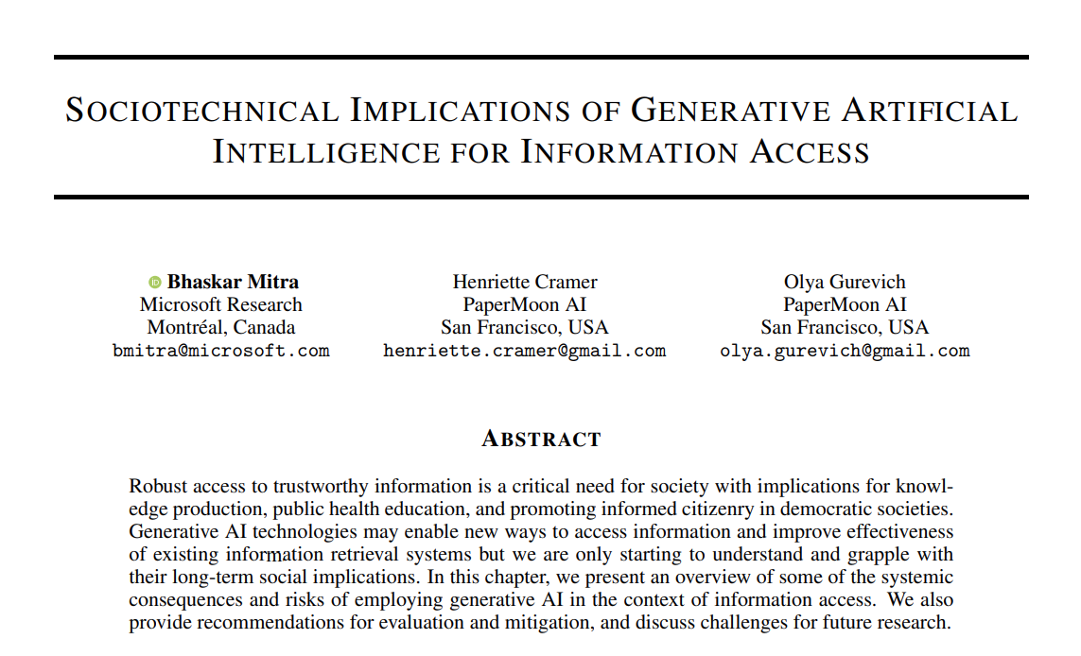
https://link.springer.com/book/9783031731464
This part of my talk is based on the following chapter from an upcoming edited book
Chapter 7
Mitra, Cramer, & Gurevich. Sociotechnical implications of generative artificial intelligence for information access. Preprint of chapter for an upcoming edited book, 2024.

Slide 7
Consequences-Mechanisms-Risks (CMR) framework
Consequences
Mechanisms
Risks
Consequences motivate viewing the changes introduced by the technology through a systemic lens
Mechanisms contribute to consequences and risks; represent sites for actionable mitigation
Risks ground any investigation or mitigation to actual potential harms on people
Identified consequences, mechanisms, and risks can be mapped to each other
High-level implications of moral import
System behaviors and process of development
Harms that may materialize for people and groups
Gausen, Mitra, & Lindley. A Framework for Exploring the Consequences of AI-Mediated Enterprise Knowledge Access and Identifying Risks to Workers. In Proc. FAccT, 2024.

Slide 8
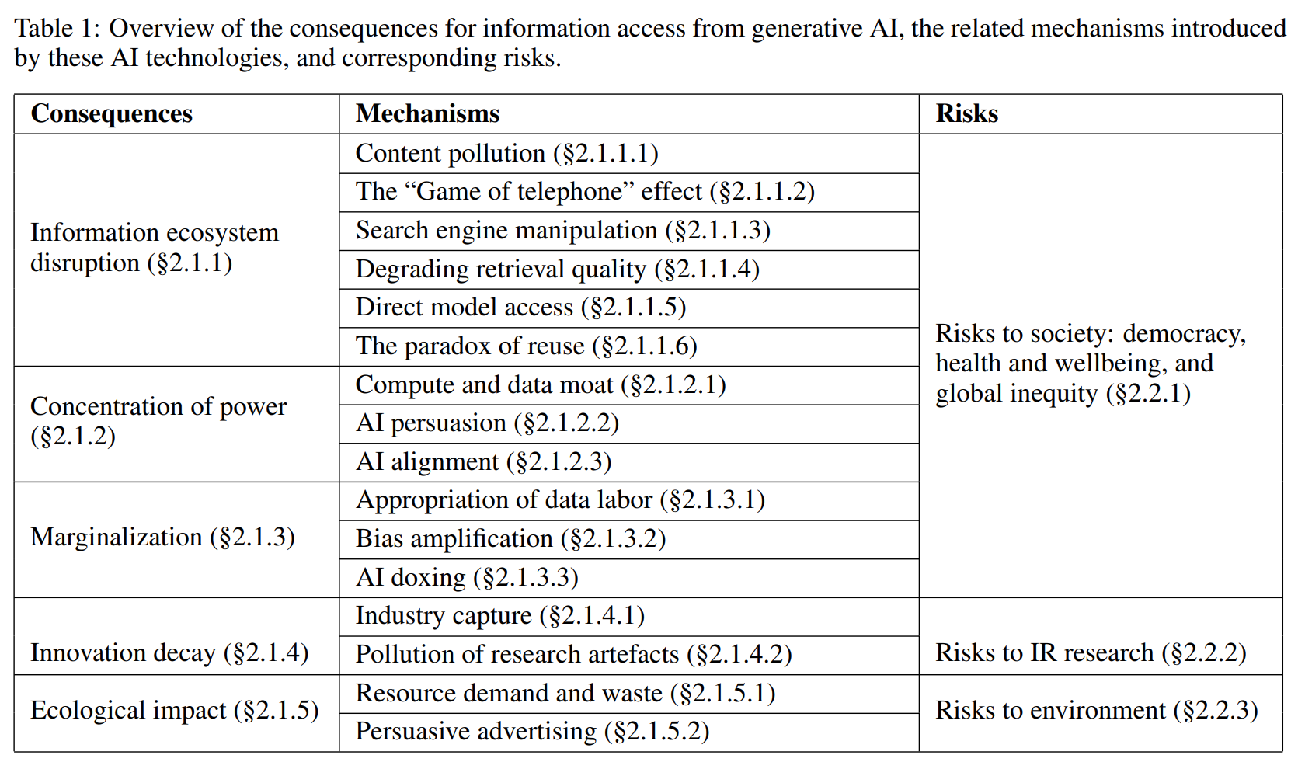
Sociotechnical implications of generative AI for information access
Mitra, Cramer, & Gurevich. Sociotechnical implications of generative artificial intelligence for information access. Preprint of chapter for an upcoming edited book, 2024.

Slide 9
Consequences of generative AI for information access
Information ecosystem disruption
Significantly changing how different actors and stakeholders in the online information ecosystem operate on their own and how they relate to each other
Concentration of power
Worsening inequities in how power and control are distributed within our society and different communities
Marginalization
Relegating certain individuals and groups to the margins of society and corresponding discrimination
Innovation decay
Ecological impact
Constraining scientific explorations to specific narrow directions while throttling progress in other areas of information access research
Worsening anthropogenic climate change
Mitra, Cramer, & Gurevich. Sociotechnical implications of generative artificial intelligence for information access. Preprint of chapter for an upcoming edited book, 2024.
Notes:
How generative AI may potentially disrupt how content is produced, consumed, monetized, and manipulated towards specific ends and how different actors and stakeholders operate and related with each other
How they shift and concentrate power while further marginalizing those at the periphery
Impact on academic research and innovation itself as well as the ecological costs of our current AI technology trends

Slide 10
Mechanisms of information ecosystem disruption
Other mechanisms
Content pollution. Enabling low-cost generation of derivative low-quality content at unprecedented scale that pollute the web.
The “Game of telephone” effect. LLMs inserted between users and search results shifts the responsibility of information inspection and interpretation to the LLM.
Search engine manipulation. E.g., prompt injection attacks.
Degrading retrieval quality. E.g., Minimizing click feedback signals.
Direct model access. Open access models pose challenges for content moderation.
The paradox of reuse
Websites like Wikipedia and StackExchange power online information access platforms, which in turn reduce the need to visit those websites.
Examples. LLMs training on content from these websites that they later regurgitate without attribution. LLM-powered conversational search systems deemphasize source websites reducing the clickthrough relative to the classic ten-blue-links interface.
Mitra, Cramer, & Gurevich. Sociotechnical implications of generative artificial intelligence for information access. Preprint of chapter for an upcoming edited book, 2024.
Notes:
Dario Taraborelli’s the “paradox of reuse”
Jeopardizing the “grand bargain at the heart of the web”
Noisy communication (instead of anthropomorphizing framing of “hallucinations”)

Slide 11
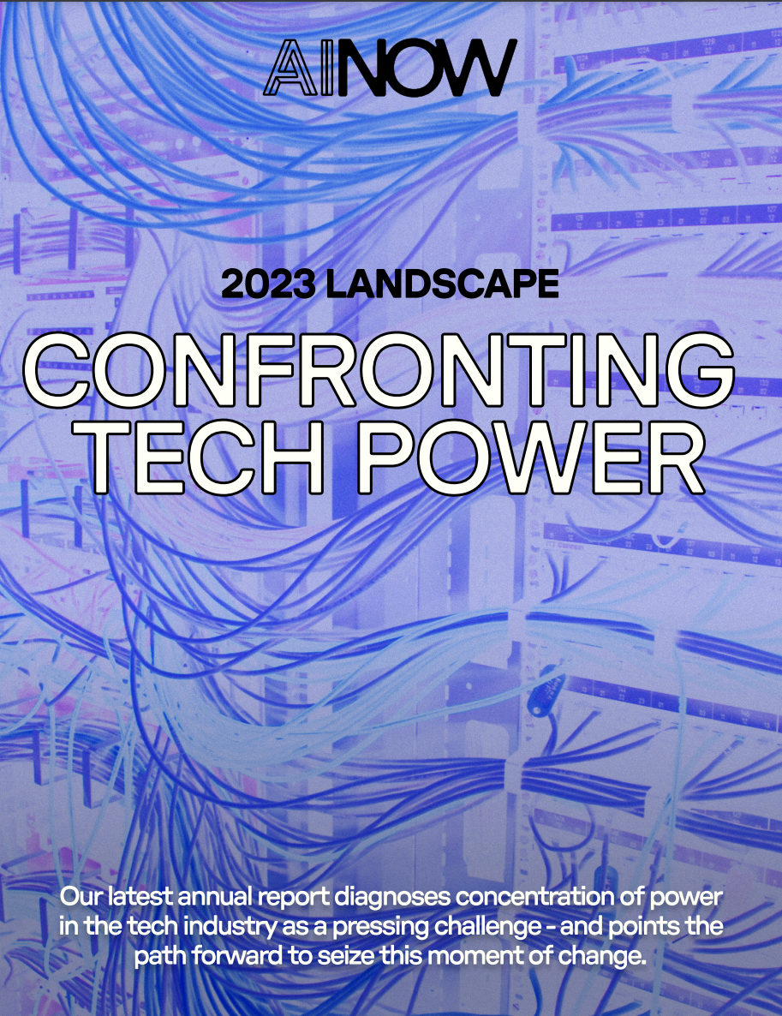
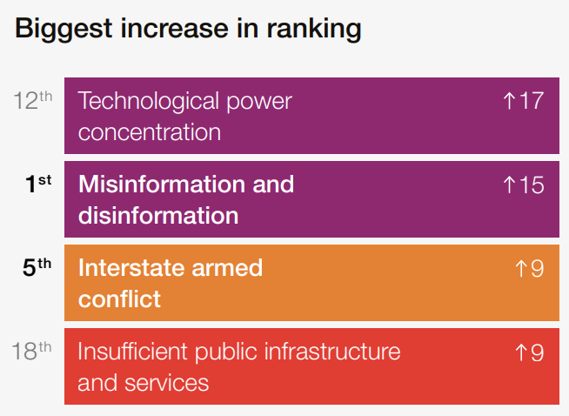

On technological power concentration
Annual change in global risk perceptions over the short term (2 years)
Mitra, Cramer, & Gurevich. Sociotechnical implications of generative artificial intelligence for information access. Preprint of chapter for an upcoming edited book, 2024.
Notes:
Not just the technologies but the narratives (both the hype and the fear-mongering) around them questionably bolsters claims of “foundational” advancements
Report from the research institute AI Now asserts the concentration of economic and political power in the hands of the tech industry as the core challenge posed by AI
2024 edition of the World Economic Forum’s Global Risks Report lists “technological power concentration” as the 12th top global risk for the coming decade and as the biggest upward mover in their annual ranking of global risks compared to the previous year.

Slide 12
Mechanisms of concentration of power
Compute and data moat. Only a handful of (typically private sector) institutions own and control the compute and data resources for training and deployment of generative AI models. Availability of “open access” models don’t fundamentally challenge the predominant vision of what AI looks like today, which would require dismantling the data and compute moat itself and turning them into public infrastructure.
AI persuasion. A process by which AI systems alter the beliefs of their users. E.g., application of LLMs for hyper-personalized hyper-persuasive ads.
AI alignment. Approaches such as reinforcement learning from human feedback (RLHF) presupposes some notions of desirable values to be determined and enforced by platform owners.
Mitra, Cramer, & Gurevich. Sociotechnical implications of generative artificial intelligence for information access. Preprint of chapter for an upcoming edited book, 2024.
Notes:
Rage-baiting
Democratic and civil society oversight

Slide 13
Mechanisms of marginalization
Appropriation of data labor
Includes the uncompensated appropriation of works by writers, authors, programmers, and peer production communities like Wikipedia and under-compensated crowdwork for data labeling that have been instrumental in the development of these technologies.
AI for me, data labor for thee. AI data labor dynamics reinforces structures of racial capitalism and coloniality, employs global labor exploitation and extractive practices, and reinforces the global north and south divide.
Other mechanisms
Bias amplification. AI models reproduce and amplify harmful biases and stereotypes from their training datasets leading to allocative and representational harms.
AI doxing. AI models may leak private information about people present in their training data or be employed to predict people’s sensitive information based on what is known about them publicly.
Mitra, Cramer, & Gurevich. Sociotechnical implications of generative artificial intelligence for information access. Preprint of chapter for an upcoming edited book, 2024.
Notes:
Data labor defined as “activities that produce digital records useful for capital generation”
Appropriation of data labor includes both (i) the uncompensated appropriation of works by writers, authors, programmers, and peer production communities like Wikipedia, and (ii) under-compensated crowdwork for data labeling that have been instrumental in the development of these technologies
These dynamics mirror and reinforce historical dimensions of racial capitalism and coloniality and global labor exploitation and extractive practices that may further amplify the global north and south divide
That is, while the global north accrues the benefits of AI, the global south is relegated to the role of producing data labor

Slide 14
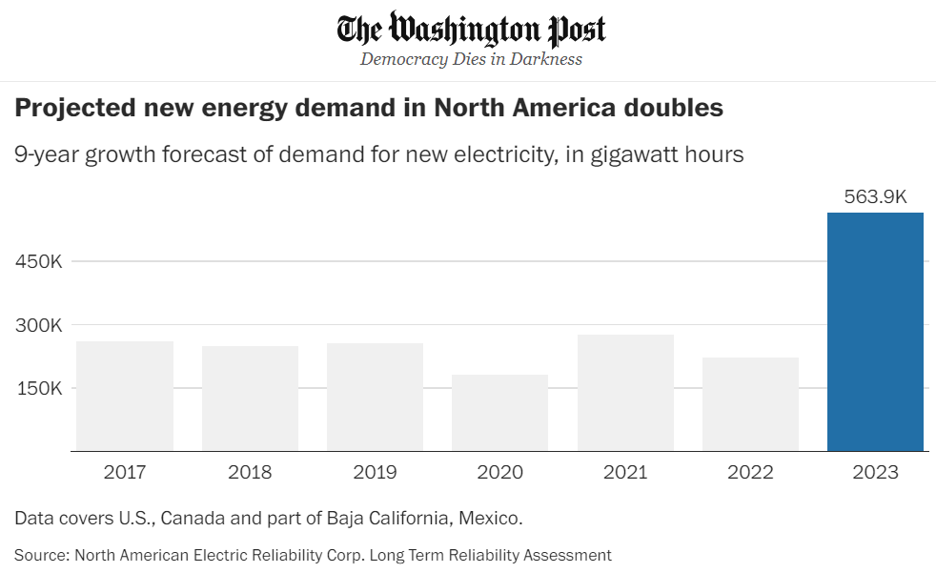
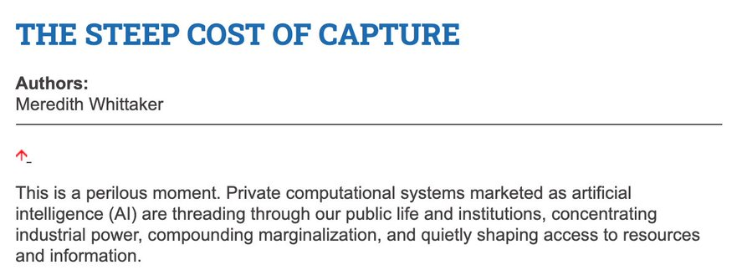
Mechanisms of…
Innovation decay
Ecological impact
Industry capture. Profit-driven goals inordinately influences scientific exploration and dissuade investments in research not immediately monetizable or which challenges the status quo.
Pollution of research artefacts. Misapplications of LLMs in scholarly publications and reviewing may negatively impact IR scholarship.
Resource demand and waste. Increasing demand for electricity and water, and electronic wastes.
Persuasive advertising. Could supercharge climate change disinformation and promote environmentally unfriendly business models like fast-fashion.
Mitra, Cramer, & Gurevich. Sociotechnical implications of generative artificial intelligence for information access. Preprint of chapter for an upcoming edited book, 2024.
Notes:
Thwart research that may not be immediately monetizable or challenges the status quo of power concentration
Ecological risks:
By some estimates, the computing power being utilized for deep learning research has been doubling every 3.4 months since 2012
In the US, data centers consumed more than 4% of their total national electricity in 2022, and that number is projected to grow to 6% by 2026
Another study estimates that by 2040 Information and Communications Technology industry on the whole alone would account for 14% of global emissions
By 2027, global AI demand may be responsible for withdrawal of 1.1 − 1.7 trillion gallons of fresh water annually
Serious concern also revolve around the rising levels of electronic wastes
Jevons paradox

Slide 15
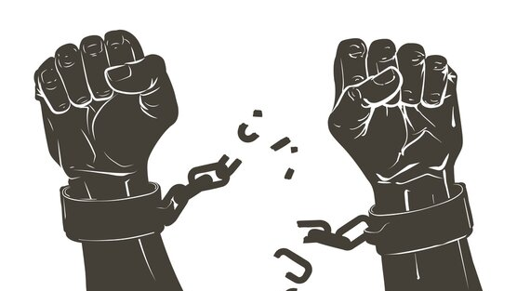
Beyond harm mitigations: Information access for our collective emancipatory futures

Slide 16

Sociotechnical imaginaries
“Visions of desirable futures, animated by shared understandings of forms of social life and social order attainable through, and supportive of, advances in science and technology”
~Jasanoff and Kim (2015)
Whose sociotechnical imaginaries are granted normative status and what myriad of radically alternative futures are we overlooking?
How does increasing dominance of established for-profit platforms over academic research influences and/or homogenizes the kinds of IR systems we build?
What would information access systems look like if designed for futures informed by feminist, queer, decolonial, anti-racist, anti-casteist, anti-ableist, and abolitionist thoughts?
Mitra. Search and Society: Reimagining Information Access for Radical Futures. ArXiv preprint, 2024.
Notes:
A salient question that is often ignored in these conversations is what futures are we building towards for our society and what role do we envision information access technologies will play towards those transformations?
Sociotechnical imaginaries: our visions of desirable sociotechnical futures
Theories of change articulate how our work and actions should take us closer towards those goals
Critically reflect on these implicit visions
Whose sociotechnical imaginaries are granted normative status and what myriads of radically alternative futures are we overlooking?
How does increasing dominance of established for-profit platforms over academic research influences and/or homogenizes the kinds of IR systems we build?
What would IR systems look like if designed for futures informed by feminist, queer, decolonial, anti-racist, anti-casteist, anti-ableist, and abolitionist thoughts, and if the focus of IR and AI research was to dismantle colonial cisheteropatriarchal capitalist structures and not to prop them up?
Shifting the frame from “how can current systems be less harmful” to “what social changes we want to affect and what systems should we build and how should we build them to make progress towards those goals”

Slide 17
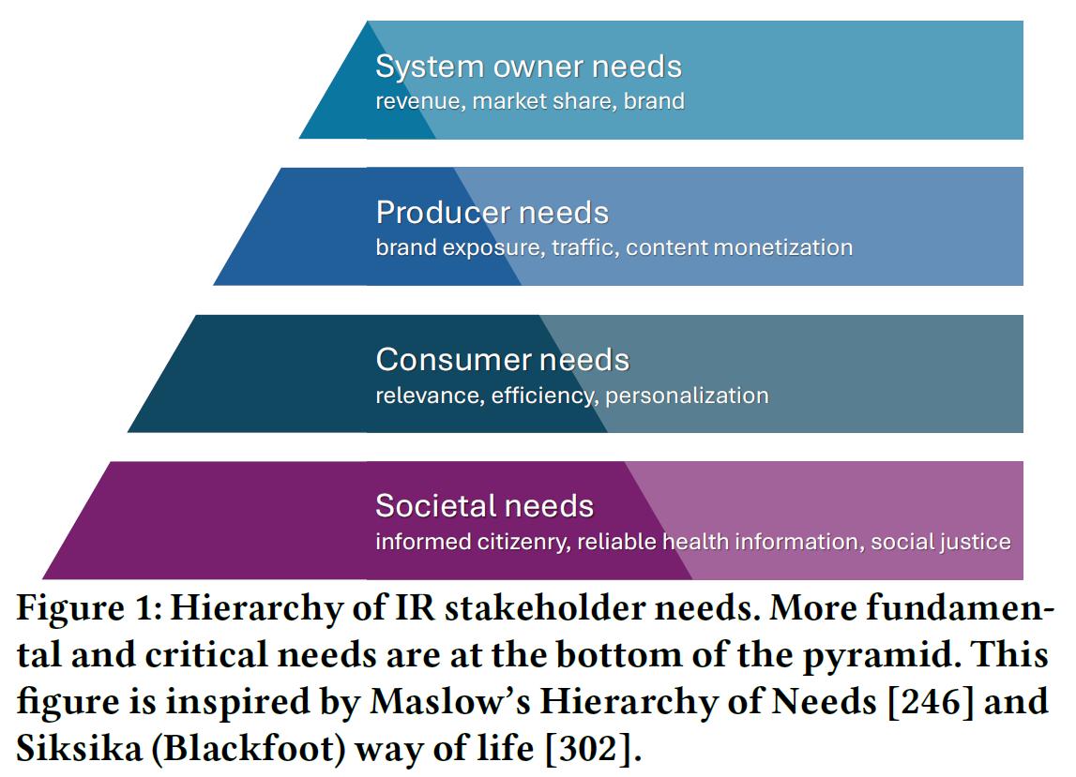
Recommendations for re-centering IR on societal needs
Explicitly articulate a hierarchy of stakeholder needs that places societal needs as the most critical concern for IR research and development
Dismantle the artificial separation between fairness and ethics research in IR and the rest of IR research; Move away from reactionary mitigation strategies for emerging technologies to proactively design IR systems for social good
Develop sociotechnical imaginaries based on prefigurative politics and theories of change
Mitra. Search and Society: Reimagining Information Access for Radical Futures. ArXiv preprint, 2024.
Notes:
User needs: relevance, personalization, and faster response times
System owner needs: revenue, market share, and brand
Content publisher needs: traffic, monetization, and exposure
Narrow lenses of harm mitigation: “how do we make the IR system fairer?” and “how do we reduce misinformation in search results?”
Without explicitly reflecting on how these systems should contribute to knowledge production, public education, and social justice
Explicitly articulate a hierarchy of stakeholder needs that place societal needs as the most critical and fundamental concern in IR system design and deployment
Dismantle the artificial separation between the research on fairness and ethics in IR and the rest of IR research
Societal needs cannot just be an afterthought nor the concern of a small subset of our research and technology communities
Instead of adopting a reactionary strategy of trying to mitigate potential social harms from emerging technologies, the community as a whole should engage in dialogs on societal good and aim to proactively set an IR research agenda for the kinds of systems we _should_ build centering on those grounded needs
Ultimately, research that attempts to affect sociotechnical change should not just transform the technology, but also every researcher and practitioner, and both are necessary for progress
It is by intentionally centering societal needs and by engaging everyone in our communities in conversations on these topics that we can develop and explicate our sociotechnical imaginaries and our theories of change

Slide 18
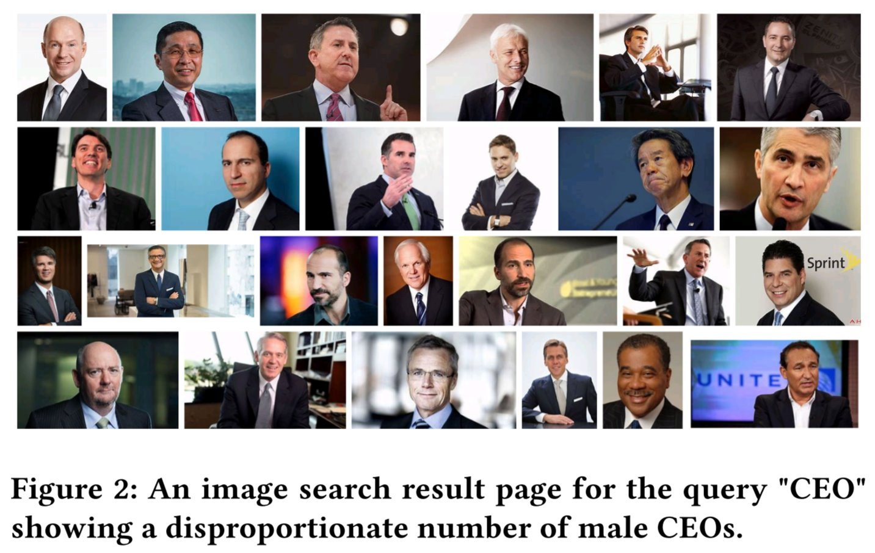


Reimagining IR through the lens of prefigurative politics
Instead of trying to algorithmically fix under-representation of women and people of color in image search results for occupational roles, can we reclaim that digital space as a site of resistance and emancipatory pedagogy by allowing feminist, queer, and anti-racist scholars, activists, and artists to create experiences that teach the history of these movements and struggles?
Can we translate Freire’s emancipatory pedagogy to strategies for anti-oppressive information access? Can search result pages support dialogical interactions between searchers that leads to knowledge production and better digital literacy?
Can emancipatory and anti-capitalist perspectives motivate us to reimagine search and recommender systems as decentralized and federated?
Mitra. Search and Society: Reimagining Information Access for Radical Futures. ArXiv preprint, 2024.
Notes:
Different paths forward:
Reclaim that digital space as a site of resistance and emancipatory pedagogy by allowing feminist, queer, and anti-racist scholars, activists, and artists to create experiences that teach the history of these movements and struggles
Emancipatory and anti-capitalist perspectives may also motivate us to reimagine search and recommender systems as decentralized and federated
Think about dialogical search interfaces that enable conversations between people for knowledge production and consensus building, not between people and the system as is the focus of conversational IR
Start from explicit sociotechnical futures and then work out what it would take to get us there, rather than starting from emerging technologies and asking how they can be made socially useful, or less harmful
This change in mindset should also encourage us to think critically about the role of organizing, mobilizing, and movement building in socially focused IR research

Slide 19
Who gets to participate?
This is a call for collective struggle of solidarity with social and political scientists, legal and policy experts, critical theorists, activists, and artists; not for technosolutionism.
To challenge the homogeneity of the future imaginaries saliently bound by colonial, cisheteropatriarchal, and capitalist ways of knowing the world, we need broad and diverse participation from our community.
Inclusion of people without inclusion of their history, struggles, and politics is simply tokenism and epistemic injustice; we should go beyond Diversity and Inclusion (D&I), and enshrine as our goal Justice, Equity, and Diversity & Inclusivity (JEDI).
Mitra. Search and Society: Reimagining Information Access for Radical Futures. ArXiv preprint, 2024.
Notes:
Not technosolutionism
We need safe spaces where IR researchers can engage with social and political scientists, legal and policy experts, critical theorists, activists, and artists, in recognition of our collective struggle to develop shared understandings of the core challenges and what IR research can offer to this process
We must approach these spaces with curiosity and humility; in recognition of our own incomplete understanding of the world; open to change and be changed by these encounters
This is also a conversation about diversity and inclusion
For our sociotechnical imaginaries to be informed by pluralistic social, cultural, and political perspectives we not only need significantly improved representation from historically underrepresented and marginalized groups, but to also be inclusive of their politics and world views
Inclusion of people without inclusion of their history, struggles, and politics is simply tokenism and epistemic injustice; we should go beyond Diversity and Inclusion and enshrine Justice and Equity as also our goal
To quote Keyes et al.: “This must be about more than just bodies: it is not diversity if we only accept marginalized people who are stripped of the epistemic models that underpin experiences of being Other, or have the work they draw from those models held to an unequal standard of legitimacy”

Slide 20
Concluding thoughts
Hope this sparks many passionate conversations and debates; radicalizes us to work on issues of social import and reflect on why we do what we do; encourages us to prioritize praxis (research activities and reflection directed at structural change) over proxies (e.g., optimizing for SOTA / leaderboard rankings that do not translate to scientific or social progress); and inspires us to build technology not just out of excitement for technology, but as an act of radical love for all peoples and the worlds we share.
“If you have come here to help me you are wasting your time, but if you have come because your liberation is bound up with mine, then let us work together.”
– Lilla Watson
and other members of an
Aboriginal Rights group in Queensland
Mitra. Search and Society: Reimagining Information Access for Radical Futures. ArXiv preprint, 2024.
Notes:
In conclusion, I hope this talk sparks many passionate conversations and debates and radicalizes us to work on issues of social import and reflect on why we do what we do. This is also a call for emphasizing praxis over proxy quantitative measures of success. By praxis I am referring to a combination of action and reflection, where the actions in this context may refer to any research activity, including but not limited to: formalization, design, experimentation, publishing, artefact creation, open sourcing, and community building. And examples of proxies may include state-of-the-art performances on benchmarks and leaderboard rankings that do not translate to better scientific understanding or positive impact on society. But above all, I hope that as a community we continue to build technology not just out of excitement for technology itself, but as an act of radical love for all peoples and the worlds we share.

Slide 21
References
Mitra. Search and Society: Reimagining Information Access for Radical Futures. ArXiv preprint, 2024.
Mitra, Cramer, & Gurevich. Sociotechnical implications of generative artificial intelligence for information access. Preprint of chapter for an upcoming edited book, 2024.
Haolun, Mitra, & Craswell. Towards Group-aware Search Success. In Proc. ICTIR, 2024.
Gausen, Mitra, & Lindley. A Framework for Exploring the Consequences of AI-Mediated Enterprise Knowledge Access and Identifying Risks to Workers. In Proc. FAccT, 2024.
Cortiñas-Lorenzo, Lindley, Larsen-Ledet, & Mitra. Through the Looking-Glass: Transparency Implications and Challenges in Enterprise AI Knowledge Systems. ArXiv preprint, 2024.
Diaz & Mitra. Recall, Robustness, and Lexicographic Evaluation. ArXiv preprint, 2023.
Raj, Mitra, Craswell, & Ekstrand. Patterns of Gender-Specializing Query Reformulation. In Proc. SIGIR, 2023.
Bigdeli, Arabzadeh, Seyedsalehi, Mitra, Zihayat, & Bagheri. De-biasing Relevance Judgements for Fair Ranking. In Proc. ECIR, 2023.
Larsen-Ledet, Mitra, & Lindley. Ethical and Social Considerations in Automatic Expert Identification and People Recommendation in Organizational Knowledge Management Systems. In proc. FAccTRec Workshop on Responsible Recommendation at RecSys, 2022.
Haolun, Mitra, Ma, & Liu. Joint Multisided Exposure Fairness for Recommendation. In Proc. SIGIR, 2022.
Li, Li, Mitra, Biega, & Diaz. Exposing Query Identification for Search Transparency. In Proc. Web Conference, 2022.
Wu, Ma, Mitra, Diaz, & Liu. A Multi-Objective Optimization Framework for Multi-Stakeholder Fairness-Aware Recommendation. In TOIS, 2022.
Cohen, Du, Mitra, Mercurio, Rekabsaz, & Eickhoff. Inconsistent Ranking Assumptions in Medical Search and Their Downstream Consequences. In Proc. SIGIR, 2022.
Seyedsalehi, Bigdeli, Arabzadeh, Mitra, Zihayat, & Bagheri. Bias-aware Fair Neural Ranking for Addressing Stereotypical Gender Biases. In Proc. EDBT, 2022.
Neophytou, Mitra, & Stinson. Revisiting Popularity and Demographic Biases in Recommender Evaluation and Effectiveness. In Proc. ECIR, 2022.
Diaz, Mitra, Ekstrand, Biega, & Carterette. Evaluating Stochastic Rankings with Expected Exposure. In Proc. CIKM, 2020.

Slide 22

“The exercise of imagination is dangerous to those who profit from the way things are because it has the power to show that the way things are is not permanent, not universal, not necessary.”
– Ursula K. Le Guin
Thank you for listening!
@UnderdogGeek
bmitra@microsoft.com
http://bit.ly/bmitraMSFT
Notes:
Thank you.

